Slide 1
Wave Data Analysis
OCE2901 – Surf Engineering Analysis

Slide 2


Preamble
Group 1: How did your first deployment go?

Slide 3

Group 2: Are you ready for your first deployment?
Is this information correct?
Date: Wednesday March 1
Time: 10:00
Place: Paradise Beach

Slide 4
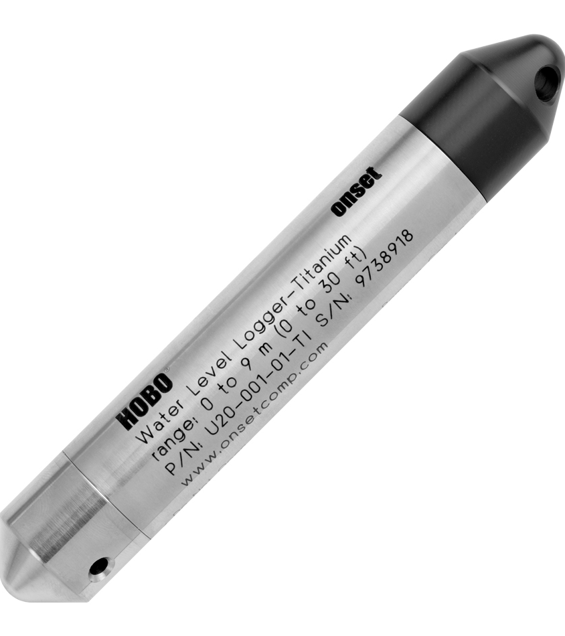
Refresher: What do our sensors record?
The HOBO U20 water level logger records the water pressure (and temperature) around it
Max Depth: <10-meters
Typical error: ±0.05% FS, 0.5 cm water
Max error: ±0.1% FS, 1.0 cm water
Resolution: 0.21 cm water

Slide 5
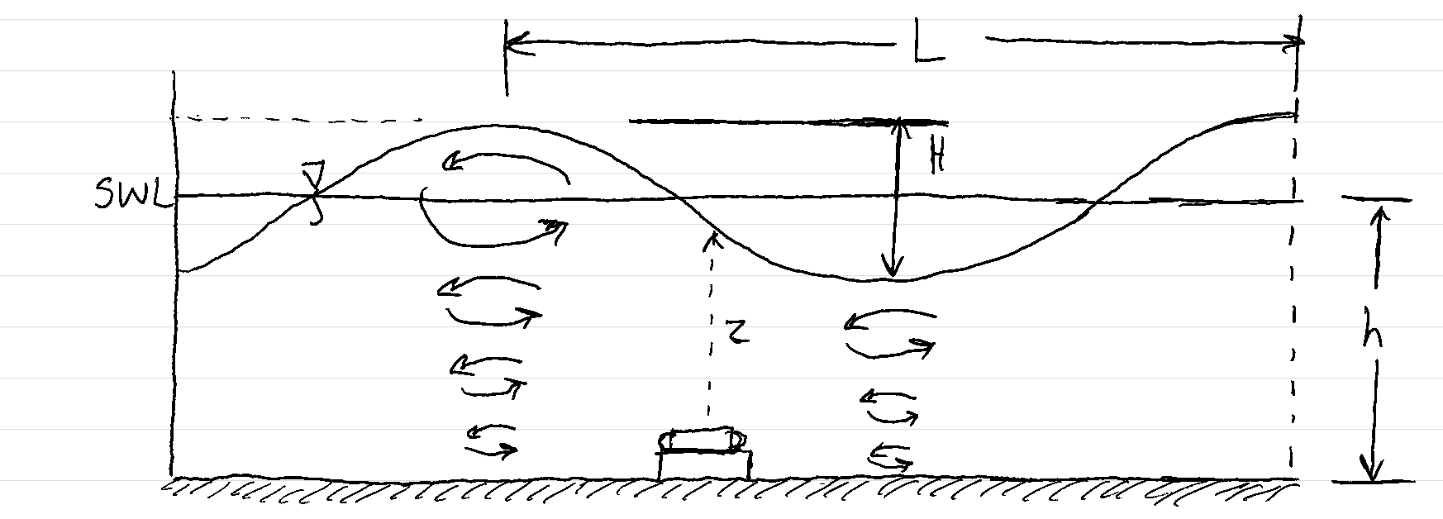
Refresher: Pressure Beneath a Wave
What two types of pressure are present at the bottom?

Slide 6
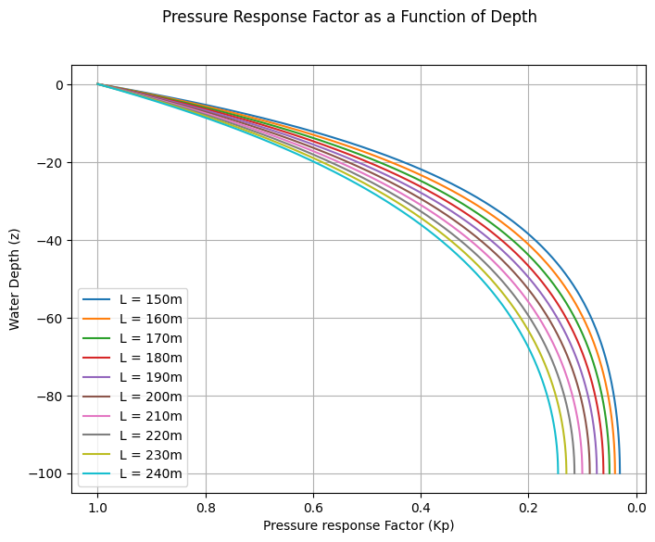












Refresher: Hydromechanical Pressure
$$P_{s}=−ρgz=ρgh, z=−h$$
$$P_{d}=ρgηK_{p}$$
$$P_{T}=ρg(h+ηK_{p})$$
$$K_{p}=\frac{\cosh\left(k\left(h+z\right)\right)}{\cosh\left(kh\right)} ≡Pressure Response Factor$$
$$k=\frac{2π}{L}≡Wave Number$$
0
Zeroth-order: $\frac{P_{T}}{ρg}−h=η$
$$at the surface, h=0$$
$$η\left(t\right)=\frac{P_{T}\left(t\right)}{ρg}$$
0
First-order: $\frac{P_{T}}{ρgK_{p}}−h=η$
$$at the surface, h=0$$
$$η\left(t\right)=\frac{P_{T}\left(t\right)}{ρgK_{p}}$$
1
Why can we assume $K_{p}=1$?

Slide 7
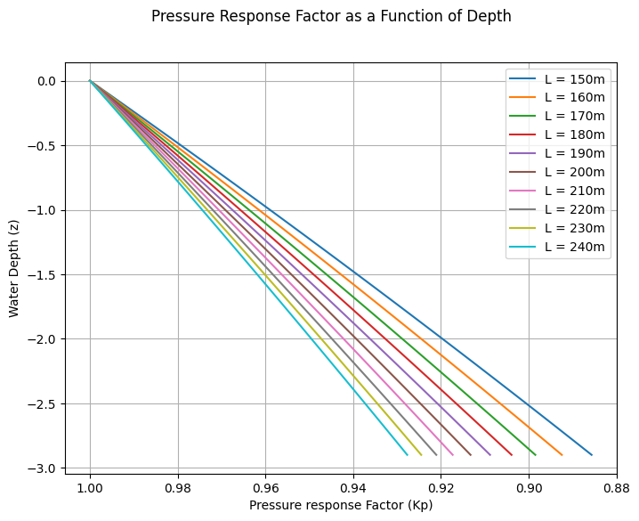

For more accuracy, we can average $K_{p}$ across multiple wavelengths at our mean depth and apply that to our pressure conversion

Slide 8
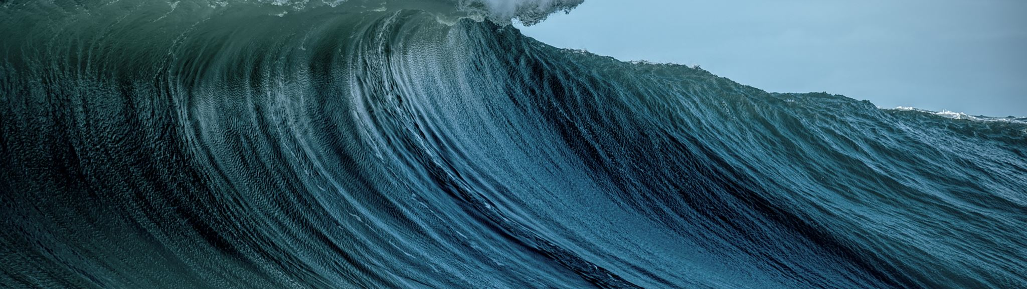
Wave-By-Wave Analysis
Determining Wave Parameters

Slide 9
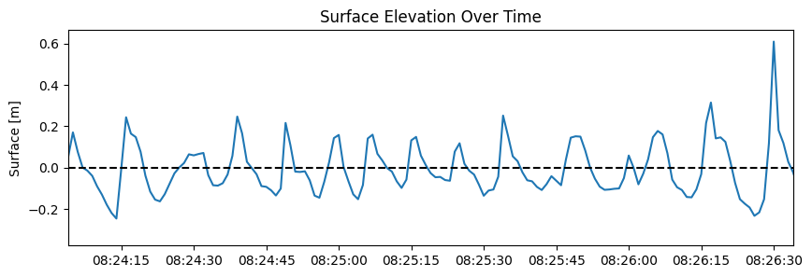
Breaking Up the Signal
Now that we have a surface elevation series, we start to gather useful information!
We need to break the continuous time signal into discrete waves which allows us to analyze the specific waves for different parameters
We can define a single wave as the surface elevation between two upcrossings or points where the elevation crosses from below to above the SWL

Slide 10
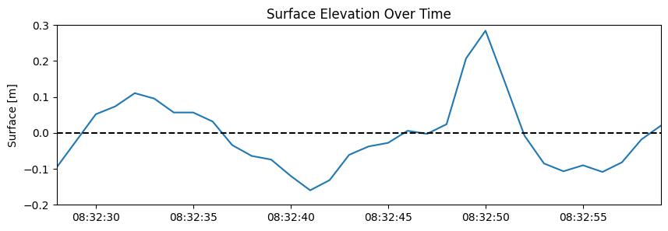

Slide 11
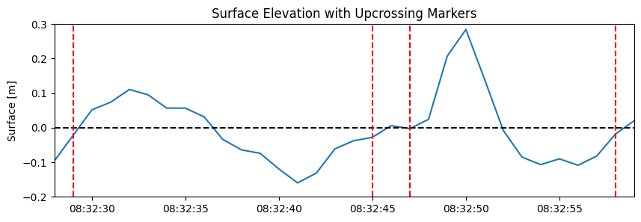
Is this significant?
1
2
3
4
5
H
T
What information can we glean from this type of plot?

Slide 12
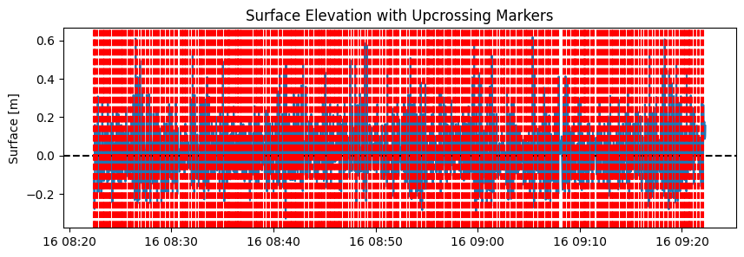

Slide 13
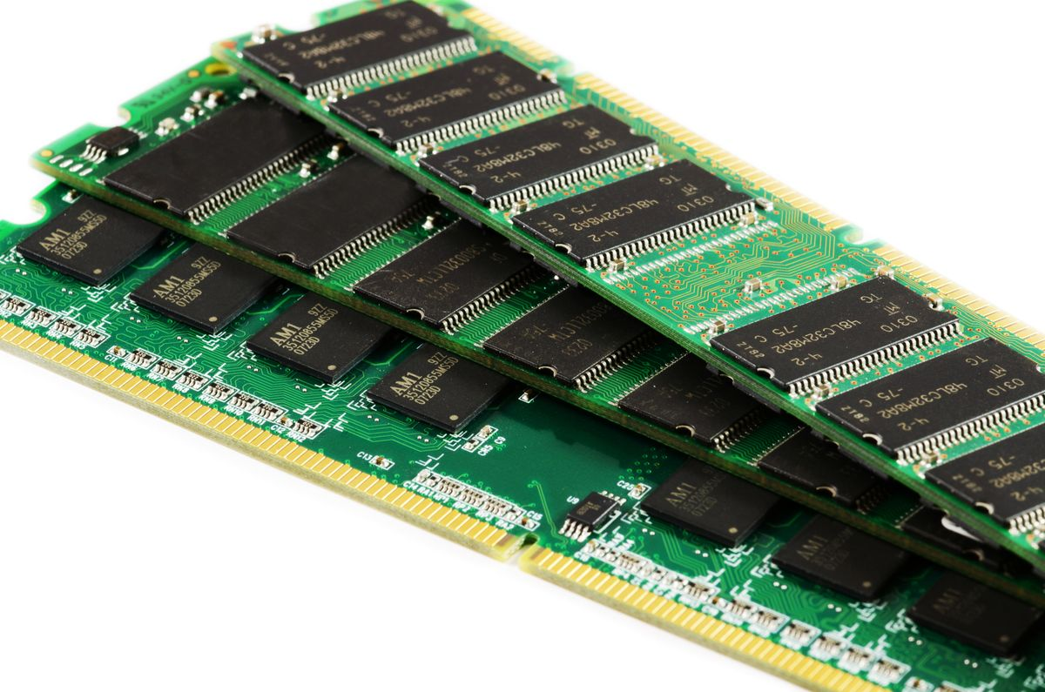





Aside: Structures
Computer memory is stored on flash modules in Random Access Memory (RAM)
Blocks of memory are called registers and by assembling registers together, we can store continuous values
If we encode how and in what order these registers are assembled, we can store large blocks of data and access it easily – these are called structures
Wave (struct)
$t$: int
𝑡: int
$T$: float
𝑇: float
$η$: array
𝜂: array
$H$: float
𝐻: float
$L_{0}$: float
𝐿_0: float
$$t$$
$$T$$
$$η$$
$$H$$
$$L_$$
D | E | A | D | B | E | E | F | … | 2 | … | 4 | …
Structures allow us to neatly organize groups of variables/data for easy access and manipulation

Slide 14
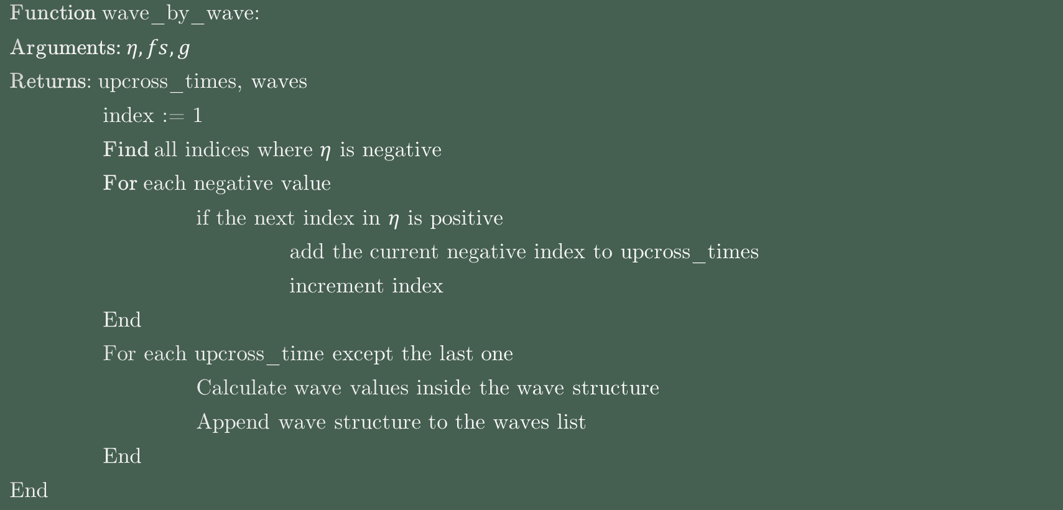
Analysis Psuedocode
Where do you think you can find practical examples of this algorithm?
Function wave_by_wave:
Arguments: $η, fs, g$
Returns: upcross_times, waves
index := 1
Find all indices where $η$ is negative
For each negative value
if the next index in $η$ is positive
add the current negative index to upcross_times
increment index
End
For each upcross_time except the last one
Calculate wave values inside the wave structure
Append wave structure to the waves list
End
End

Slide 15
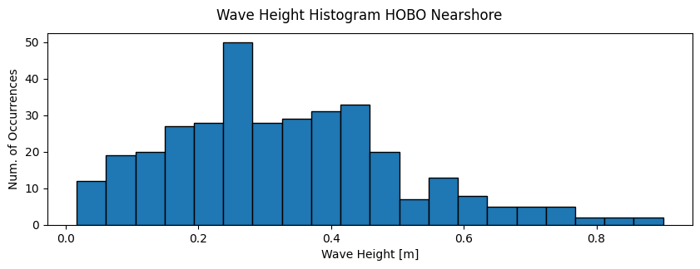
Probabilities

Slide 16
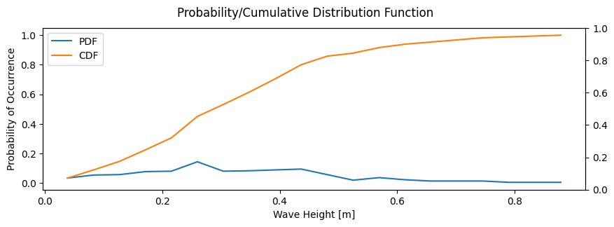
Probabilities

Slide 17
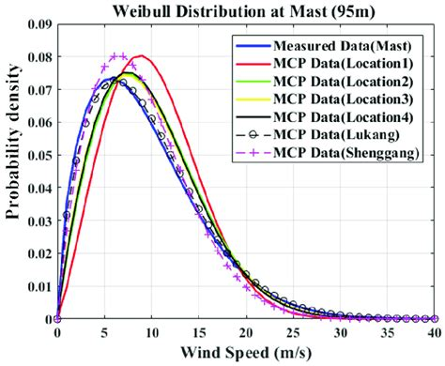
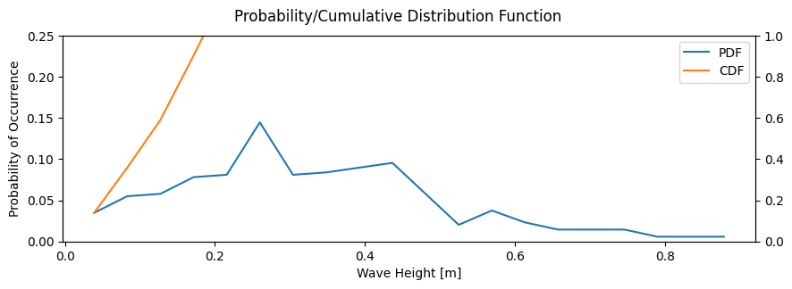
Probabilities
The PDF should follow some known distribution like Weibull or Rayliegh

Slide 18
Other Metrics
Does this apply for wave period as well?
First, place the wave heights into a sorted descending order
MATLAB and Python have easy functions to do this
$$\overline{H}=\frac{1}{N}\sum_{i=0}^{N}{H_{i}}$$
𝐻 ̅=1/𝑁 ∑_(𝑖=0)^𝑁▒𝐻_𝑖
Magnitude of the Varying Wave Height
$$H_{rms}=\sqrt{\frac{1}{N}\sum_{i=0}^{N}{H_{i}^{2}}}$$
𝐻_𝑟𝑚𝑠=√(1/𝑁 ∑_(𝑖=0)^𝑁▒𝐻_𝑖^2 )
Maximum wave height
Average Wave Height
$$Max(H)$$
Max(𝐻)
Minimum wave height
$$Min(H)$$
Min(𝐻)
Most common wave height
$$Mode(H)$$
Mode(𝐻)
Middle wave height
$$Median(H)$$
Median(𝐻)
Mean of the highest $\frac{1}{n}$ waves
Mean of the highest 1/𝑛 waves
$$\overline{H_{\frac{1}{n}}}=\frac{1}{n}\sum_{i=0}{H_{i}}$$
(𝐻_(1/𝑛) ) ̅=1/𝑛 ∑_(𝑖=0)▒𝐻_𝑖
Significant wave height
Mean of the highest 1/3 of waves

Slide 19

Introspective
What Does It All Mean?

Slide 20

Questions?

